Slide 1
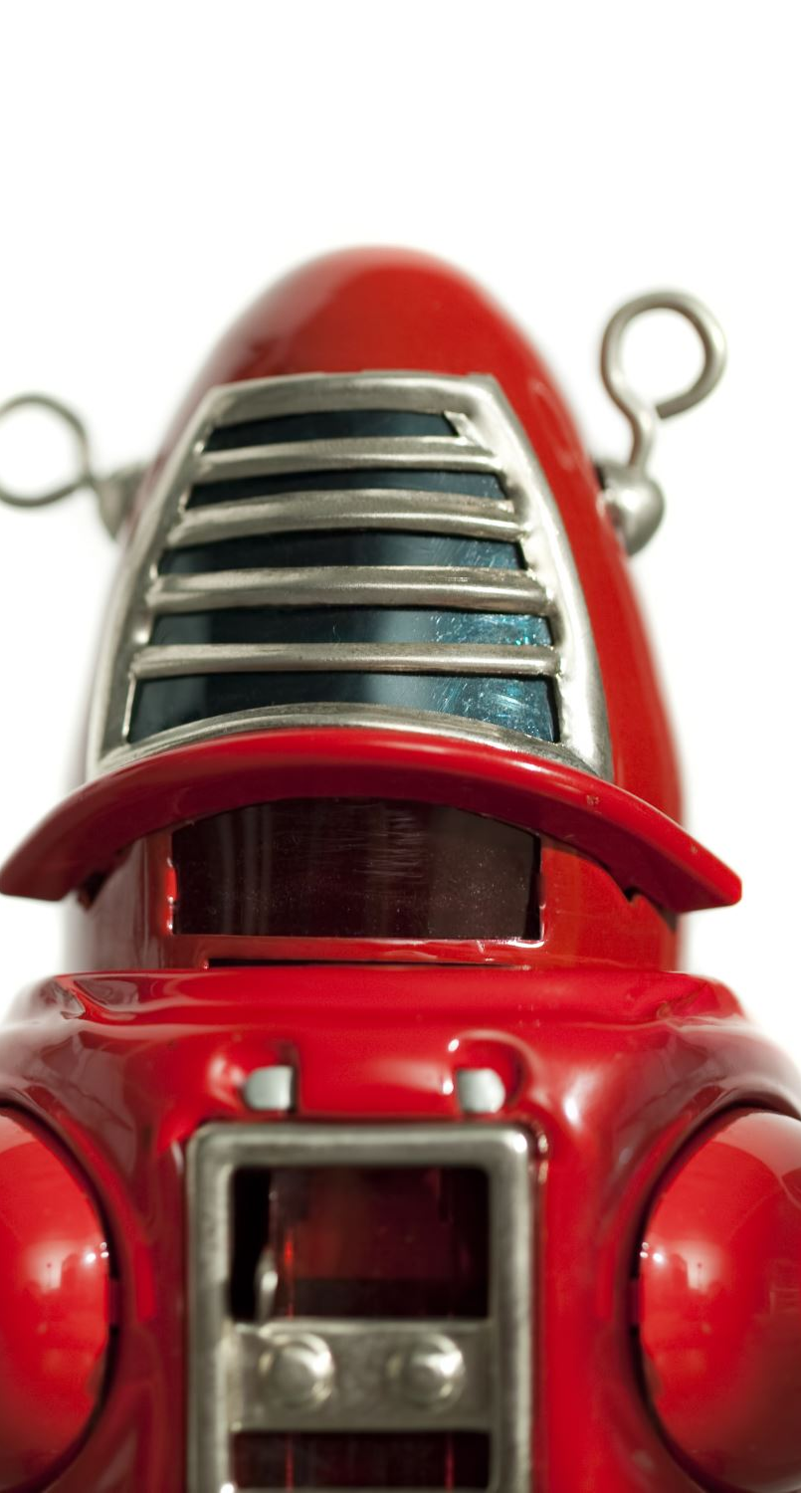
UART RECEIVER
BY
180040256 – N.ESWAR
180040257 – K.Y Sagar
180040263 – P.SRI VIDYA

Slide 2
CONTENT
INTRODUCTION
METHODOLOGY & BLOCK DIAGRAM
IMPLEMENTATION
OUTPUT
APPLICATIONS
CONCLUSION

Slide 3
INTRODUCTION
UART, which stands for Universal Asynchronous Receiver/Transmitter is a circuit for sending parallel data through a serial line.
A universal asynchronous receiver-transmitter is a computer hardware device for asynchronous serial communication in which the data format and transmission speeds are configurable.
Receiver: All operations of the UART hardware are controlled by an internal clock signal which runs at a multiple of the data rate, typically 8 or 16 times the bit rate. The receiver tests the state of the incoming signal on each clock pulse, looking for the beginning of the start bit. If the apparent start bit lasts at least one-half of the bit time, it is valid and signals the start of a new character. If not, it is considered a spurious pulse and is ignored.
Transmitter : As soon as the sending system deposits a character in the shift register (after completion of the previous character), the UART generates a start bit, shifts the required number of data bits out to the line, generates and sends the parity bit (if used), and sends the stop bits. Since full-duplex operation requires characters to be sent and received at the same time, UARTs use two different shift registers for transmitted and received characters.
A UART is a computer hardware device for a asynchronous serial communication in which data format & transmission speeds are configurable.

Slide 4
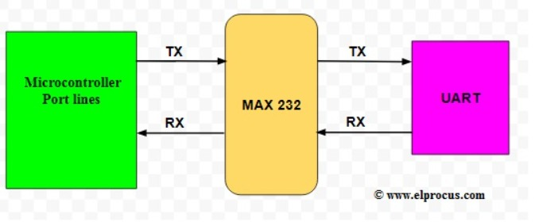
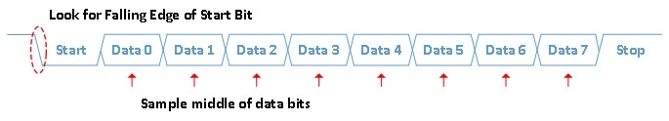
METHODOLOGY & BLOCKDIAGRAM
Asynchronous transmission allows data to be transmitted without the sender having to send a clock signal to the receiver.
In asynchronous transmission , the sender sends a start bit, 5 to 8ndata bits (LSB first),an optional parity,and then 1,1.5 or 2 stop bits.
BLOCK DIAGRAM

Slide 5
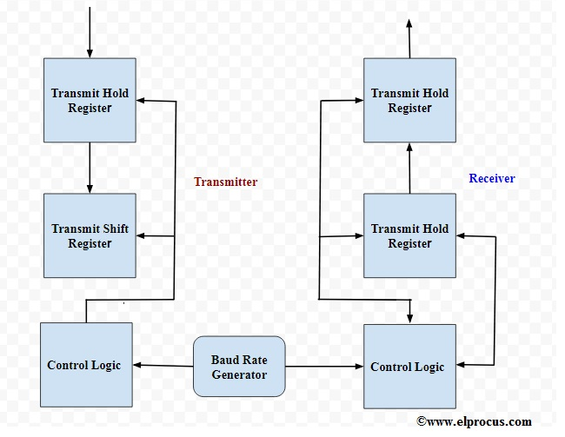
Block Diagram

Slide 6
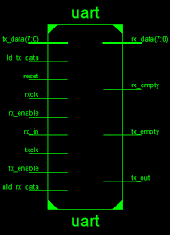
IMPLEMENTATION

Slide 7
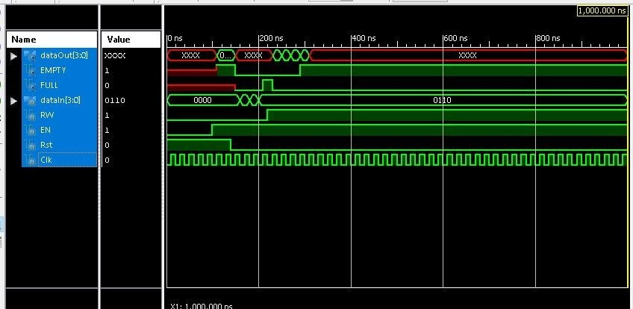
OUTPUT

Slide 8
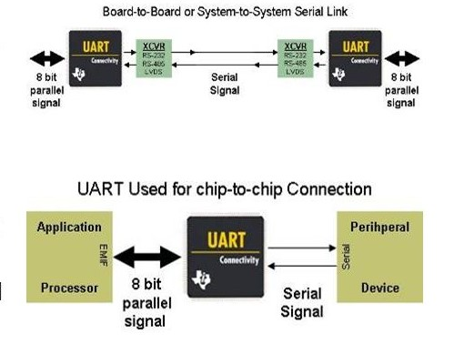
APPLICATIONS
UART is one of the most simple and most commonly used Serial Communication techniques.
Today, UART is being used in many applications like GPS Receivers, Bluetooth Modules, GSM and GPRS Modems, Wireless Communication Systems, RFID based applications etc.

Slide 9
CONCLUSION
This bit is usually used by receiver to perform simple error checking.
Lastly, Stop bit will be sent to indicate the end of transmission.

